Slide 1
Yesterday
Learning Intention: Understand the concepts of Place and Place Perception and what effects how people perceive a place.
Success Criteria: Able to state what Perception of place and list the filters that effect how people may perceive the same place differently.

Slide 2
Today
Learning Intention: Understand the concept of sense of place and what works to influence our perception of place.
Success Criteria: Apply what was learnt yesterday and analyse perceptions of places and identify factors that have influenced your perception of their place.

Slide 3
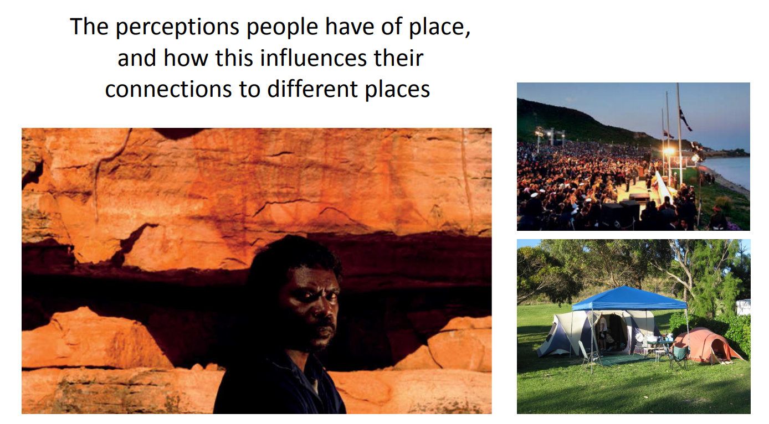

Slide 4
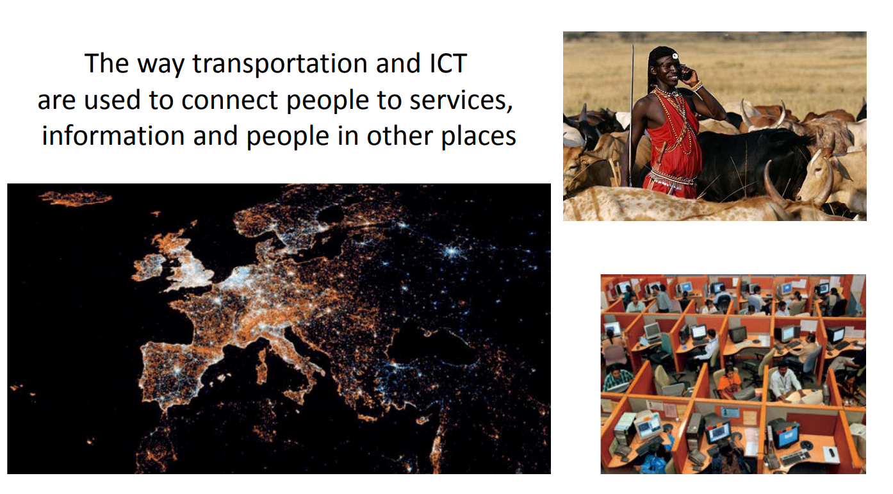

Slide 5
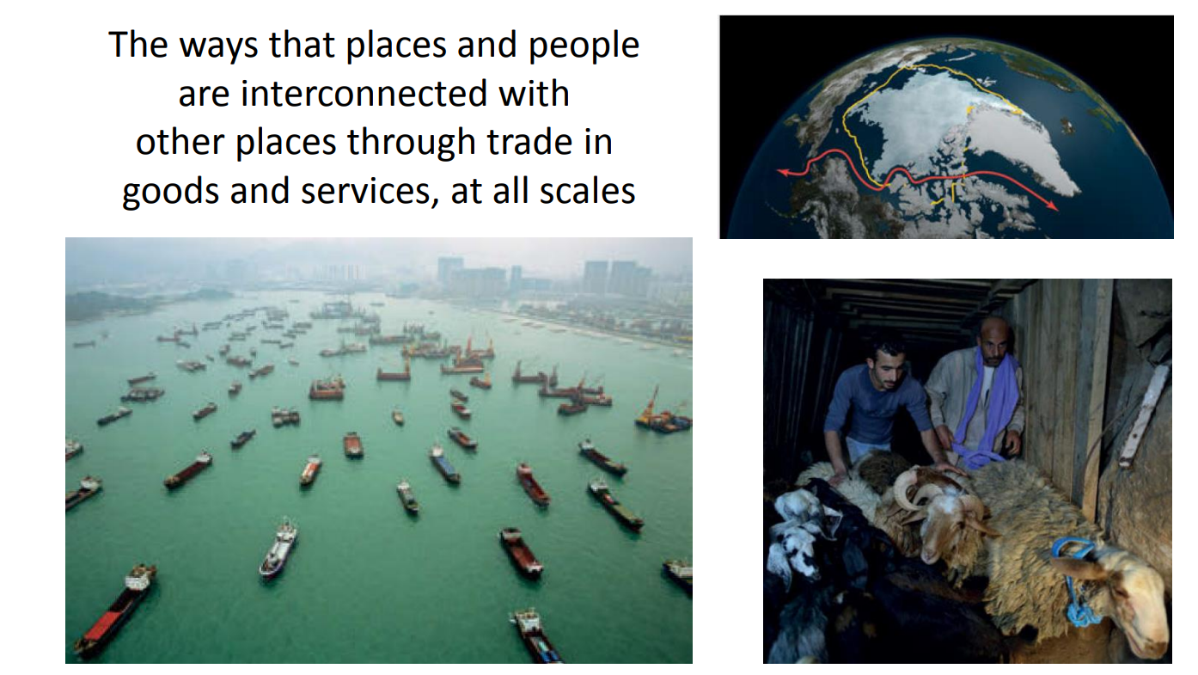

Slide 6
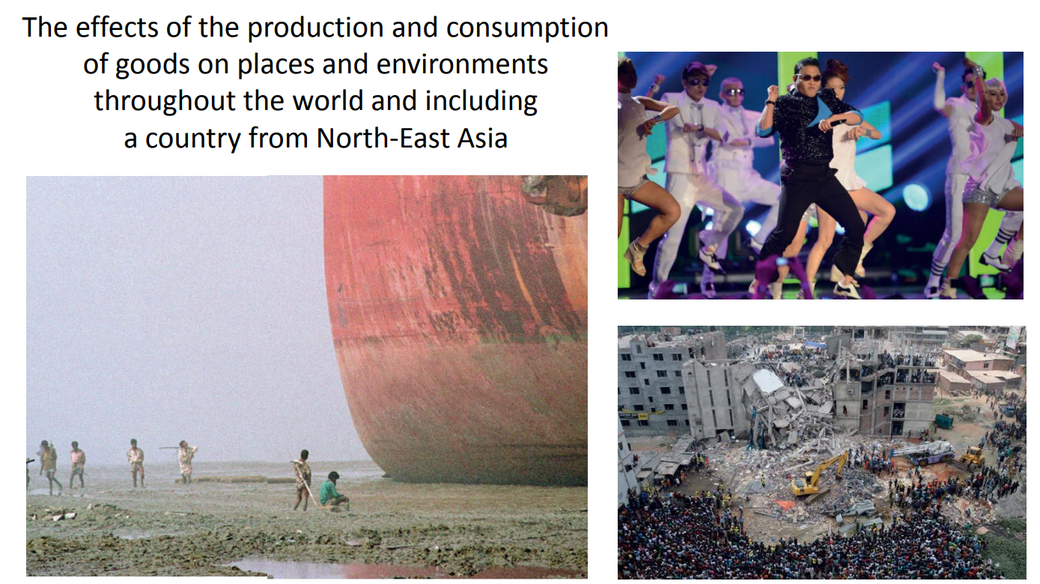

Slide 7
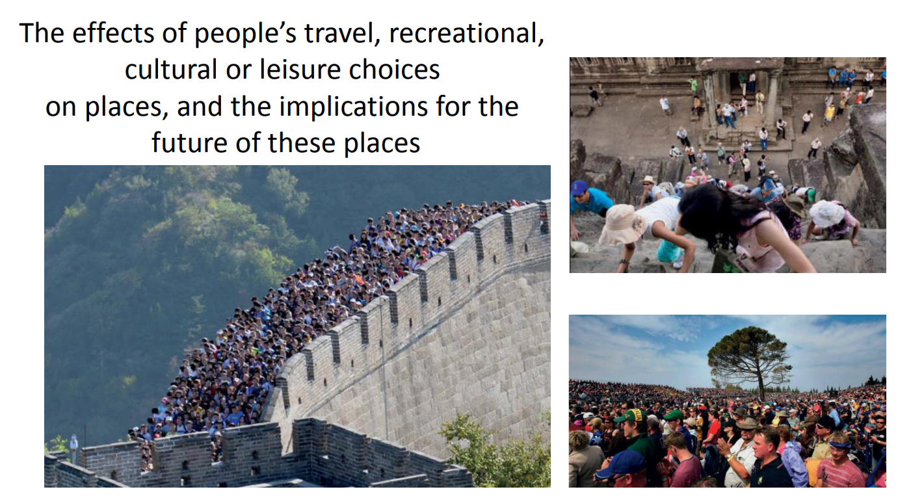

Slide 8
Developing a perception

Slide 9


Slide 10


Slide 11


Slide 12
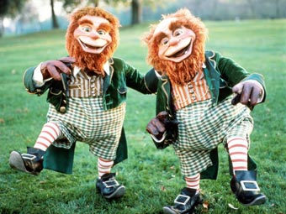

Slide 14
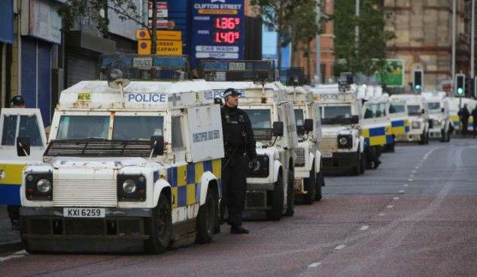

Slide 15


Slide 16


Slide 17


Slide 18


Slide 19


Slide 20
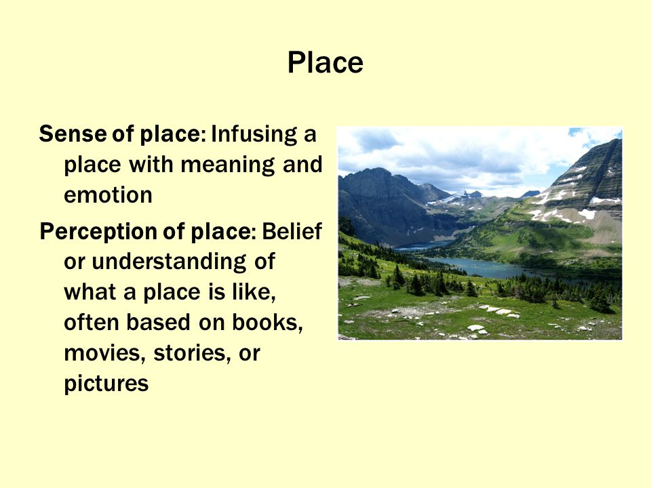

Slide 21
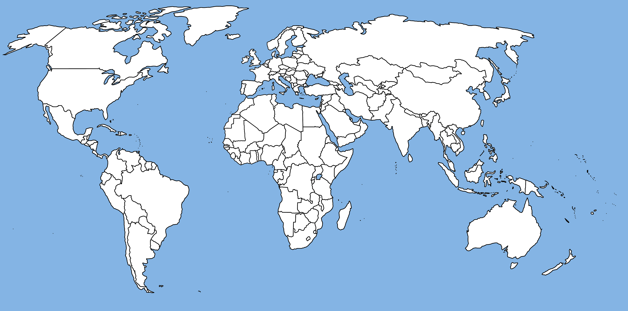

Slide 22


Slide 24


Slide 25


Slide 26


Slide 27
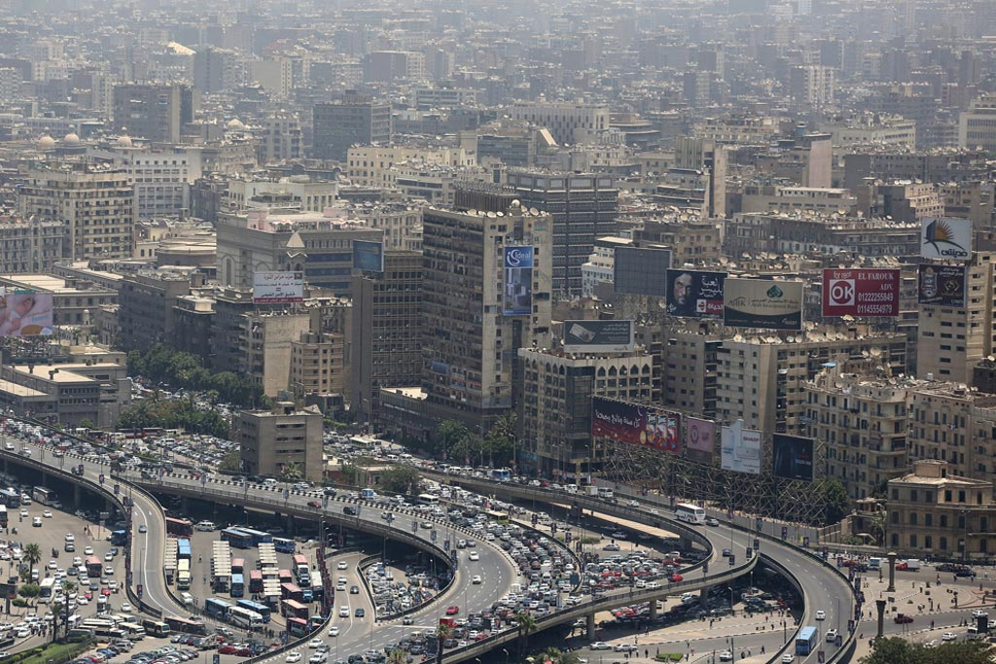

Slide 28
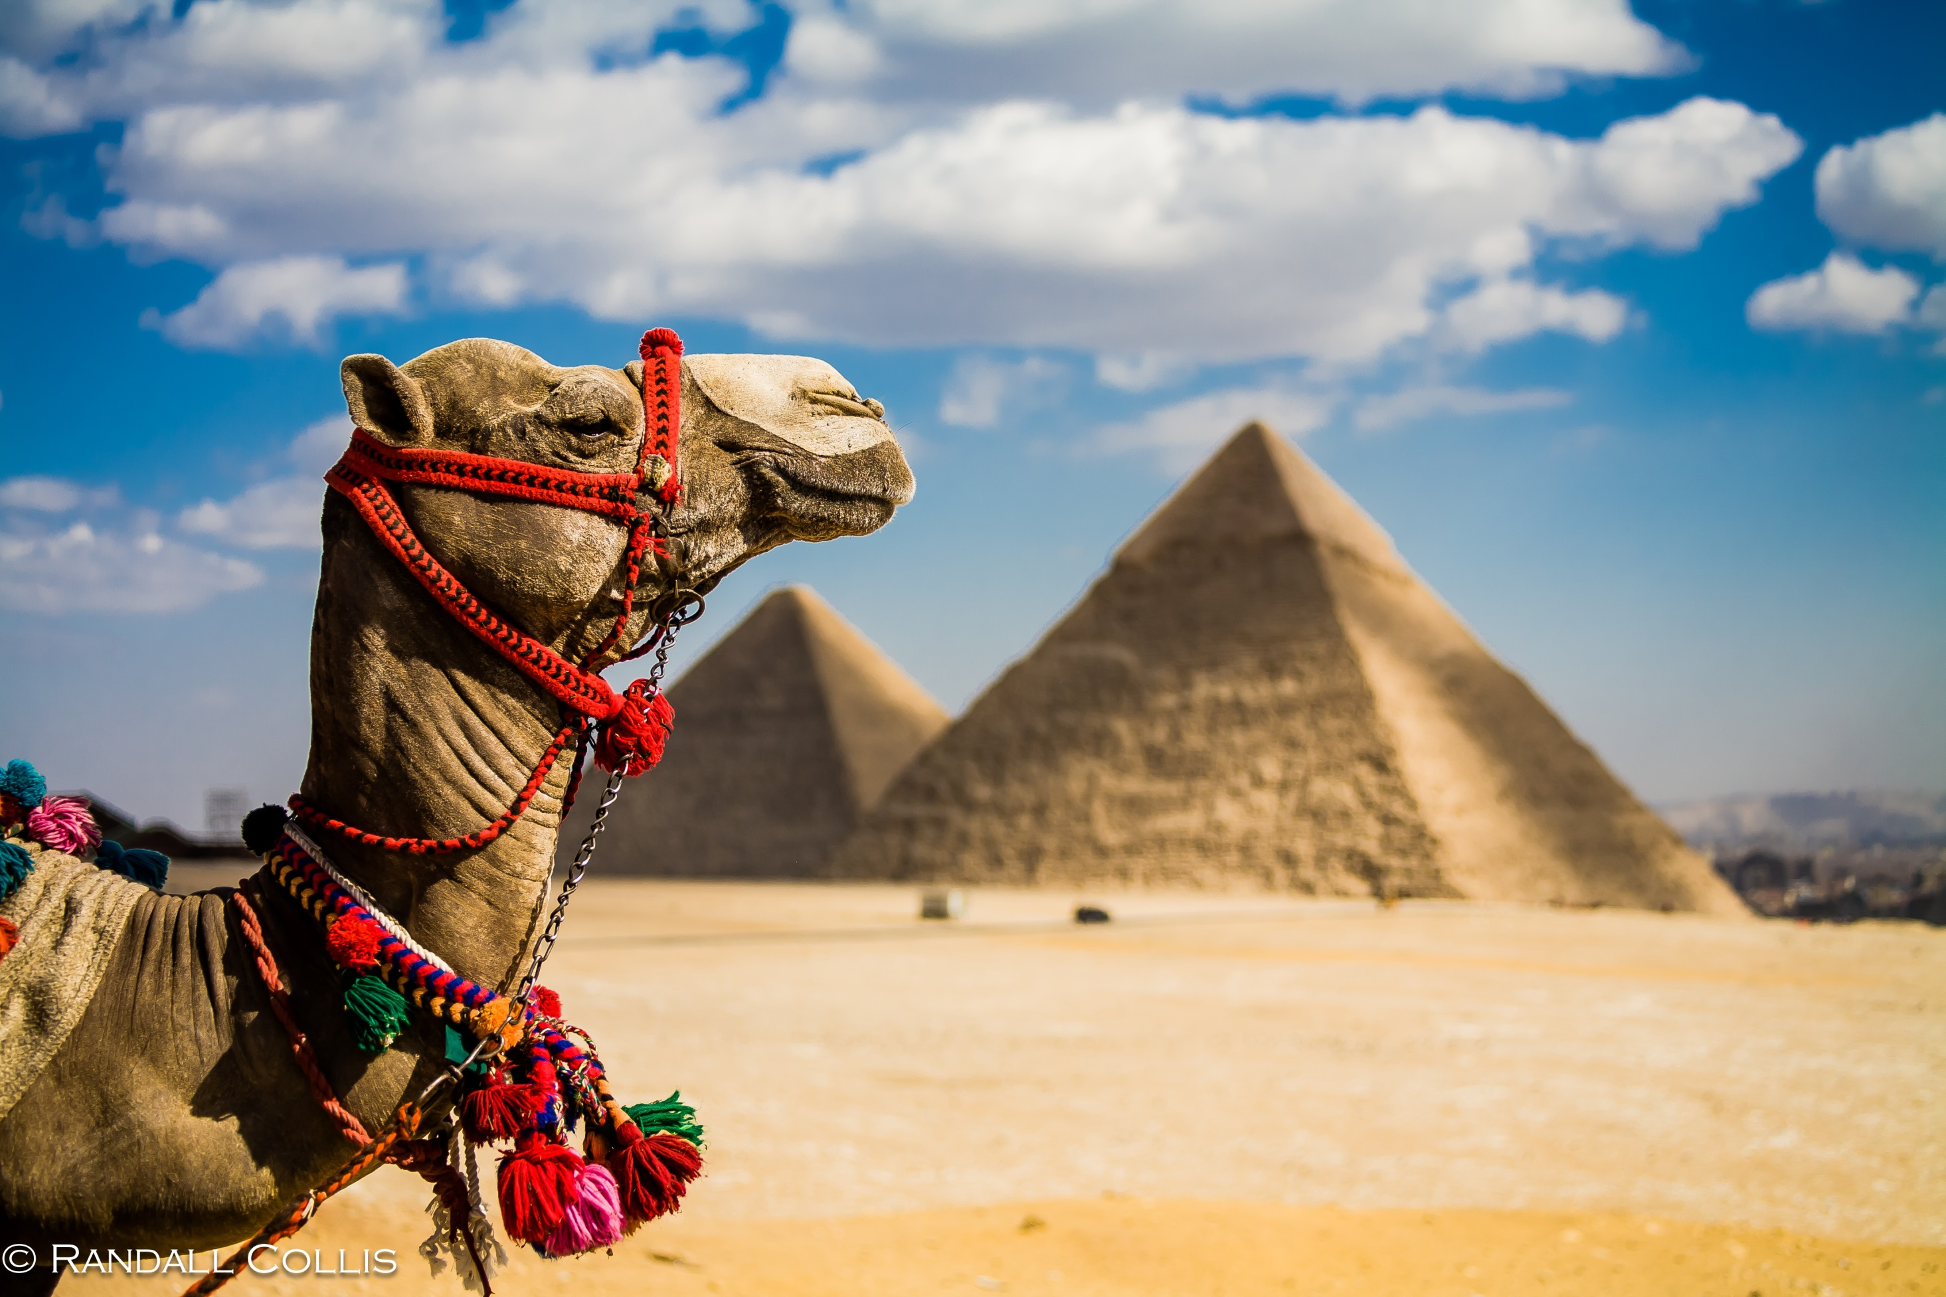

Slide 29


Slide 30


Slide 31


Slide 32
